Slide 1

Your Guide to Smart, Healthy, and Convenient Meals.
Hoan Nguyen, John Nguyen, Victor Le, Joji Maldonado, Josue Cruz, Felix Huang IS 385 Fall 2018

Slide 2
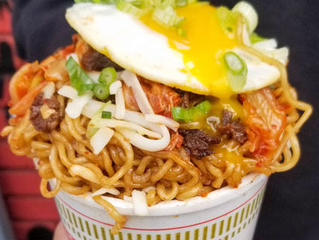
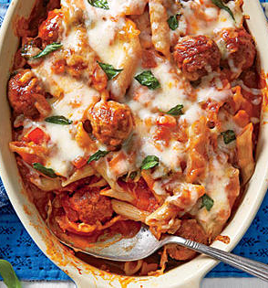
Scenario:
Meatball Pasta Bake
Or
Super Ramen

Slide 3
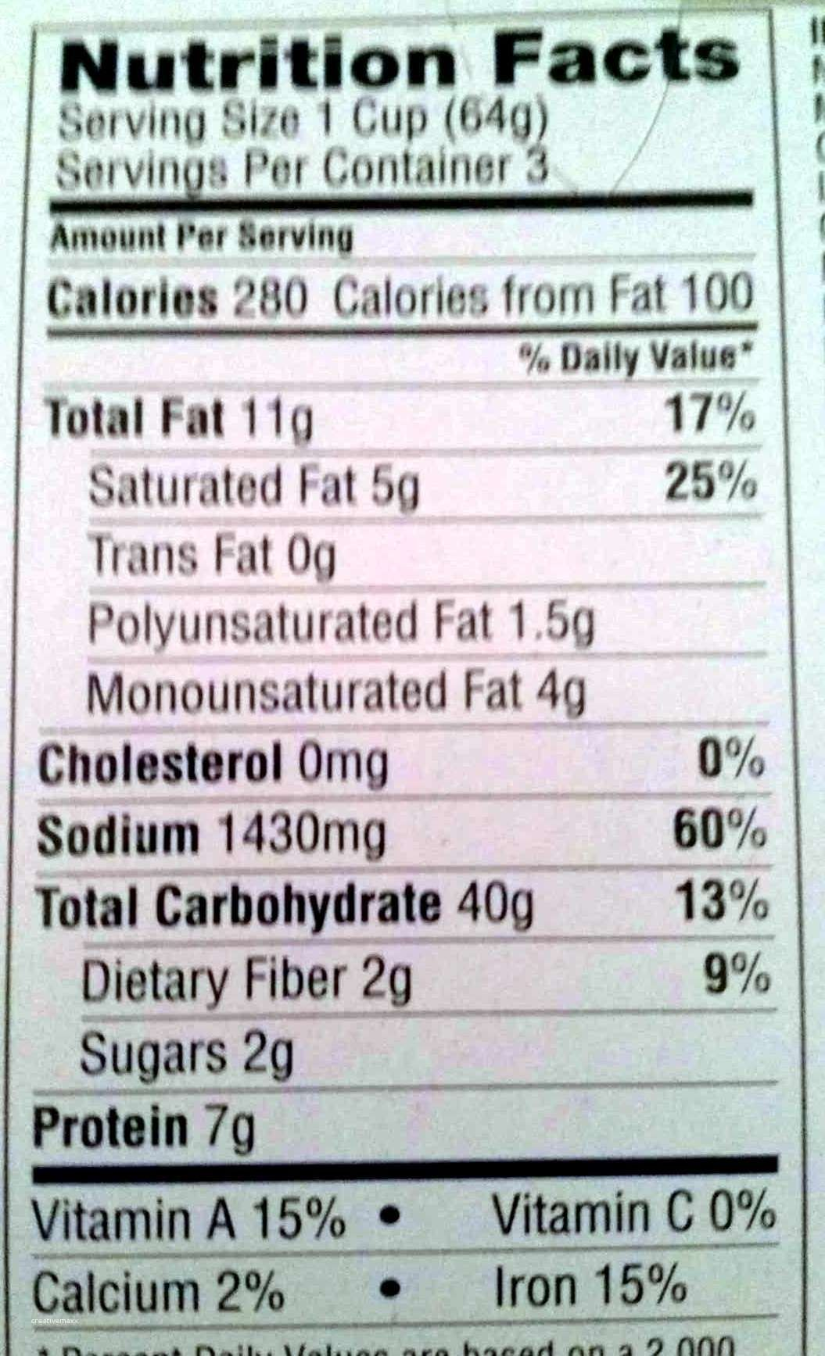

Unpractical & Unhealthy
1 (16-oz.) package penne pasta
1 small sweet onion, chopped
1 medium-size fennel bulb, thinly sliced (optional)
2 tablespoons olive oil
3 garlic cloves, minced
1 teaspoon fennel seeds
2 (24-oz.) jars marinara sauce
2 (14-oz.) packages frozen beef meatballs, thawed
1 cup fresh orange juice
3/4 cup organic chicken broth
1 teaspoon firmly packed orange zest
1 medium-size red bell pepper, chopped
1/2 teaspoon kosher salt
1 cup torn fresh basil
1 1/2 (8-oz.) packages fresh mozzarella cheese slices
Garnish: fresh basil leaves

Slide 4
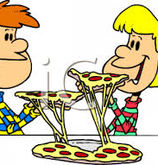
The Problem
As a society, we are losing our independence in our kitchens
Meals prepared at home for mid-level income households decreased from 92% to 69%
Spending $3000 annually eating out
We are unaware of what our food consists

Slide 5

The Solution…

Slide 6
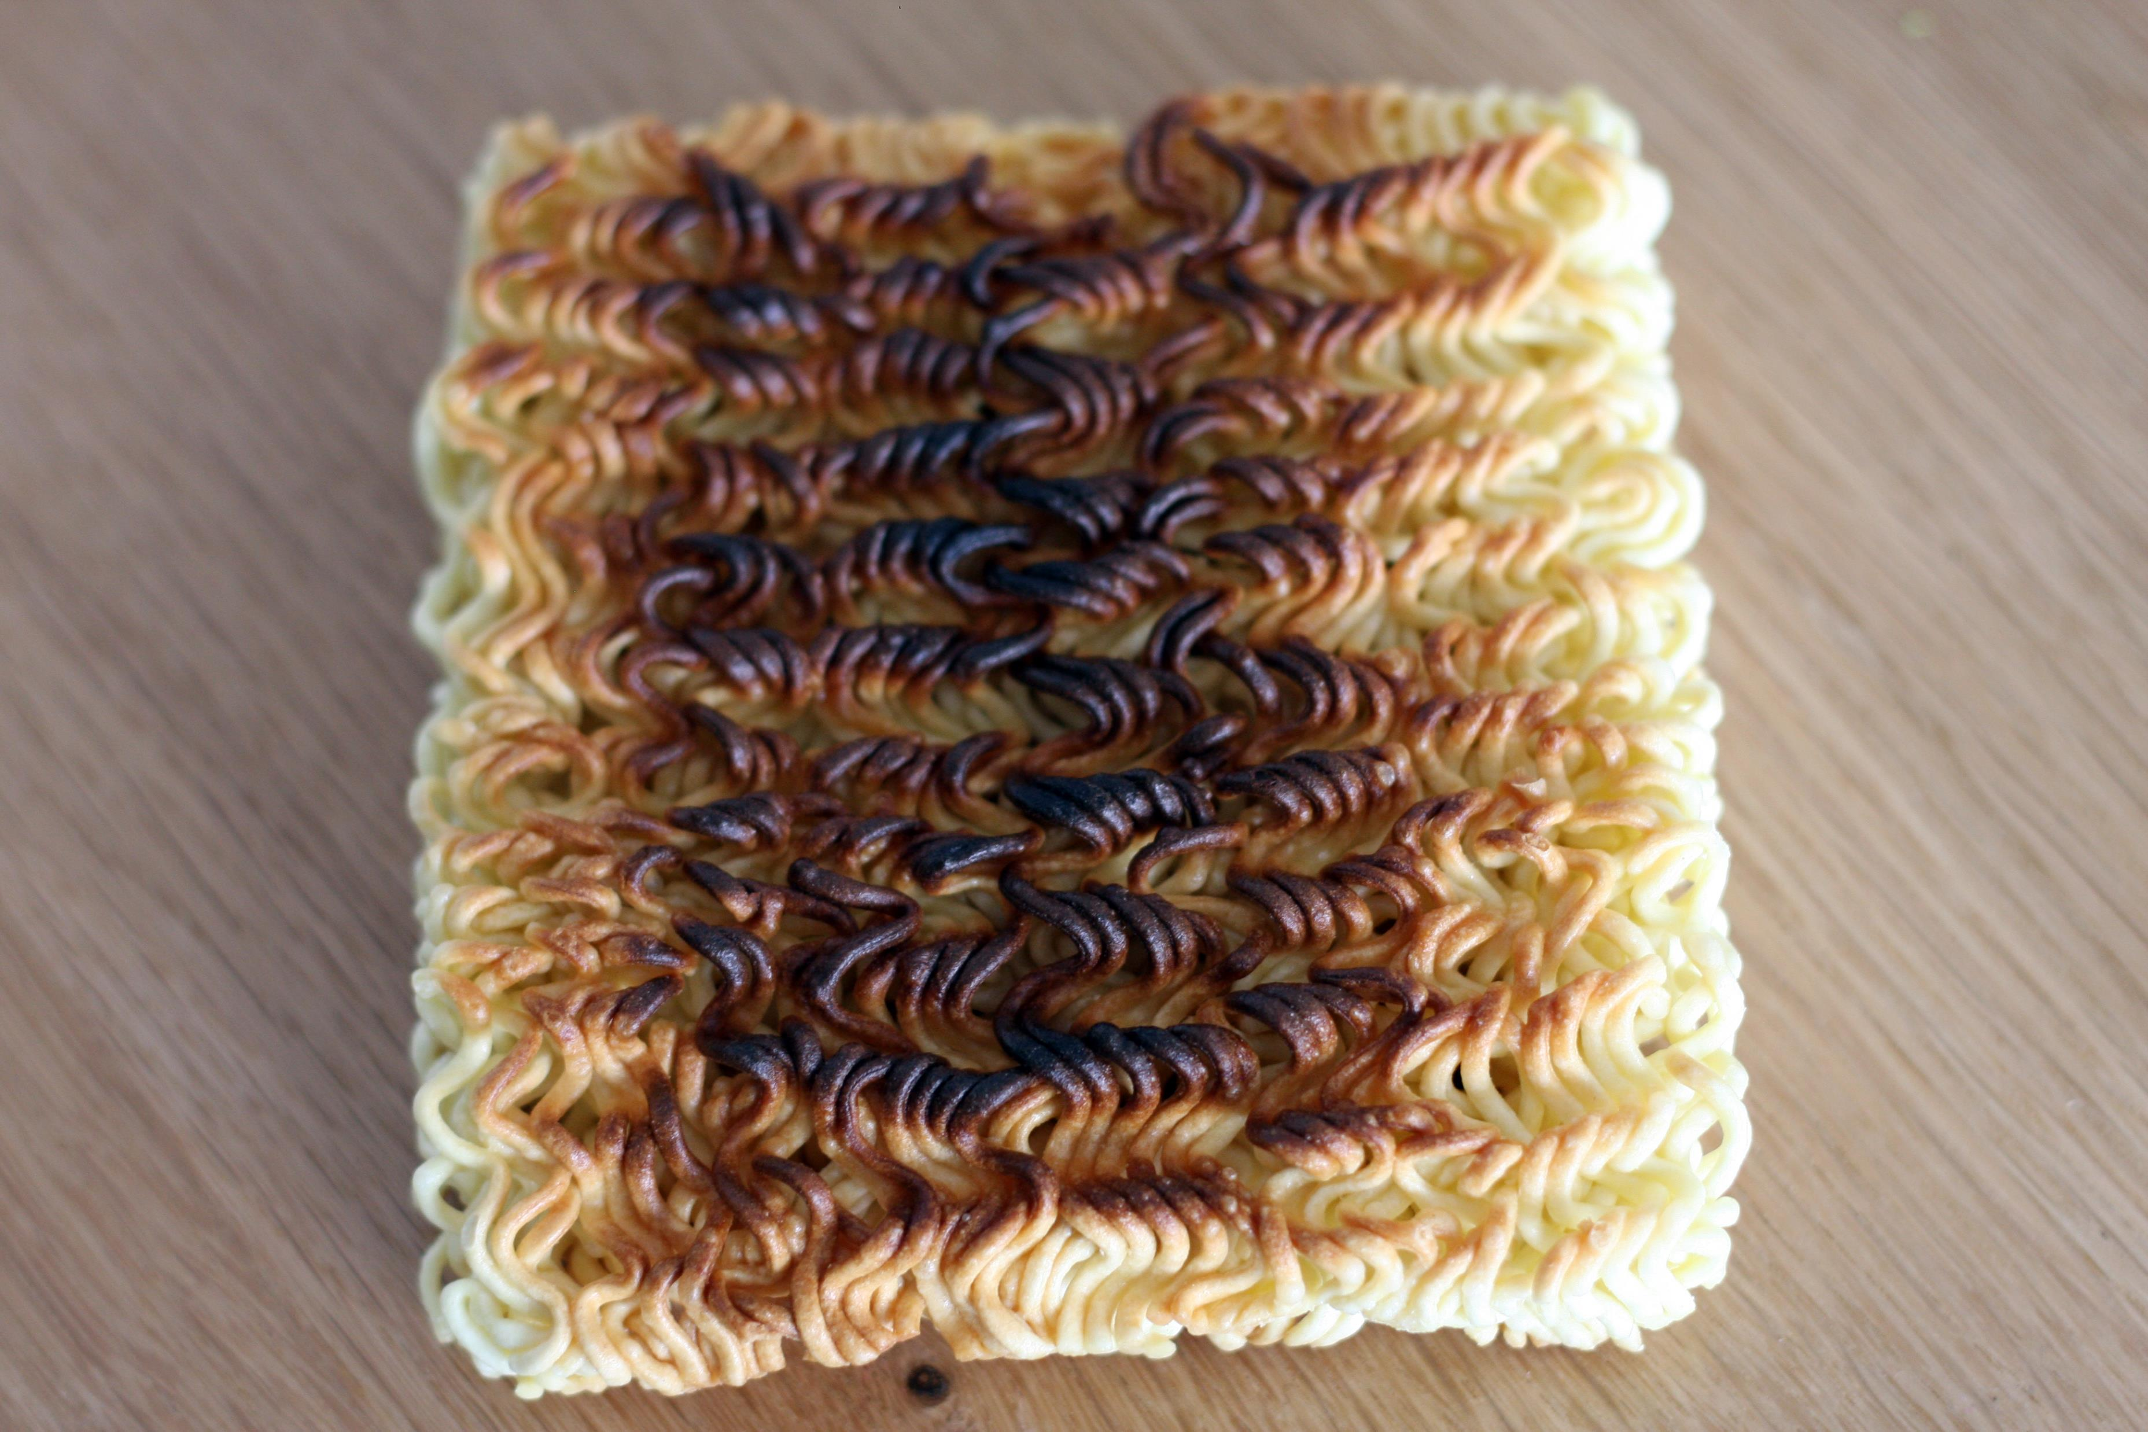
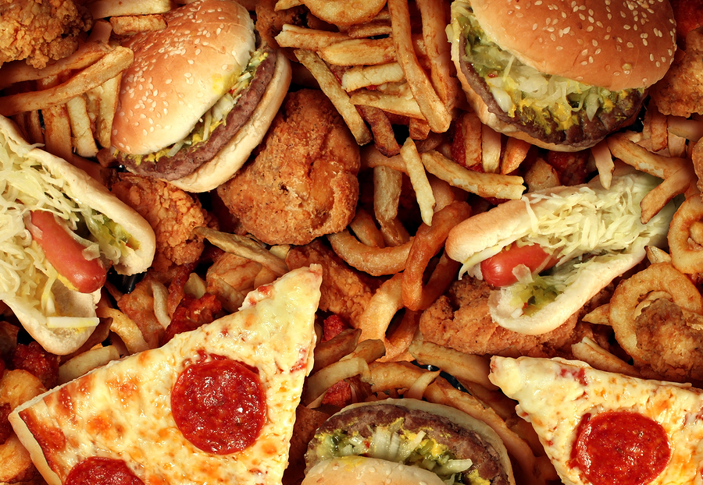
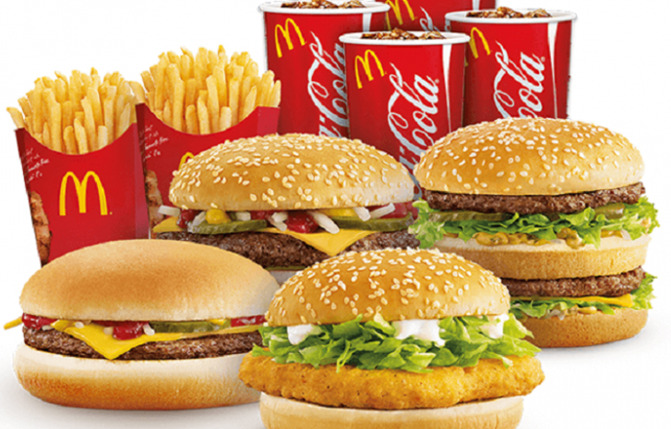
Go From This ….
Notes:
Go from processed foods, take out, and burnt noodles …

Slide 7

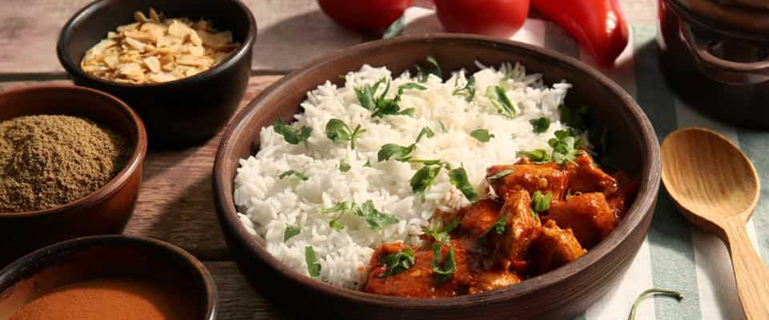
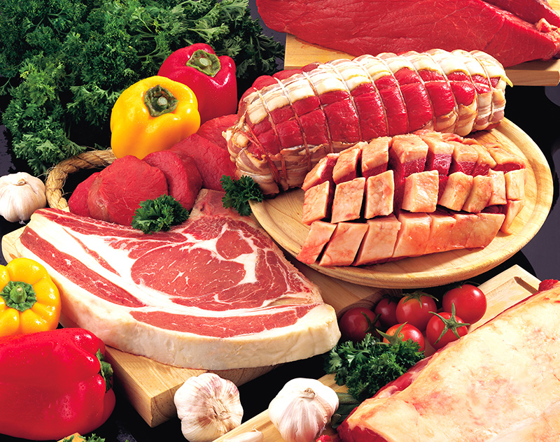
…to this!
Notes:
… to getting your own fresh produce to cook your own fresh and healthy alternative

Slide 8
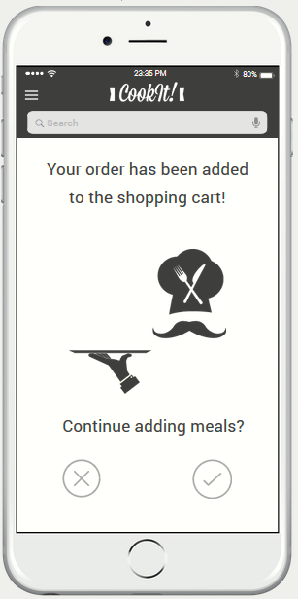
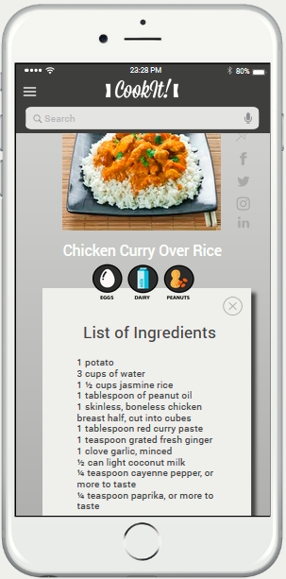
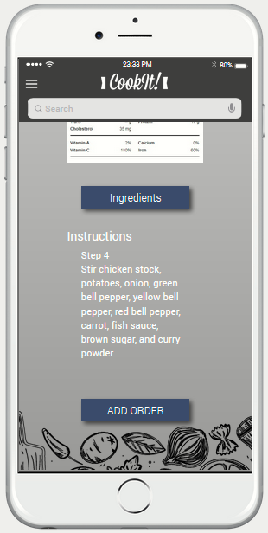
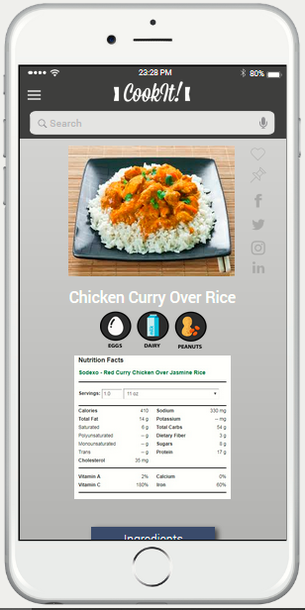
CookIt! Is Smart Eating And Convenience All Pack into a User Friendly App
Notes:
How? By using our CookIt App!

Slide 9
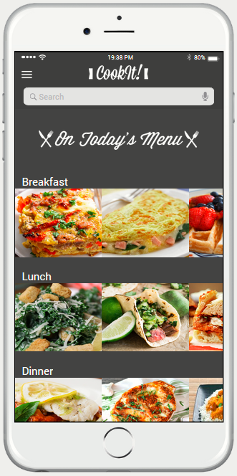
CookIt! Provides You with Healthy Meal Options Everyday of the Week!
Notes:
Search for meals based on time of day, based on ingredients or by scrolling through your favorites.
Cook it will guide you through the rest of the steps for a fresh cooked home meal.

Slide 10
Each Meal Includes Recipe and Instructions
Notes:
Cook it will show you a list of ingredients that you can purchase at your local grocery store and simple to follow instructions from step 1 to completion.

Slide 11
Each Meal Includes Nutrition Labels
Every meal includes nutrition facts that provide information you need to make healthy choices and stay healthy
Information helps with health concerns, such as weight control, diabetes and high blood pressure
Notes:
We do all the math for you when you to recalculate the nutrition facts if you change the serving size of the standard meal.
This gives you an advantage over processed foods that are made in warehouses and sit on a counter for a long time.
For example, when you buy a cup of noodle, you don’t have the option to make it healthy. You can make it worse by adding more processed ingredients such as hot sauce, but you can’t adjust the fat or sodium content.

Slide 12
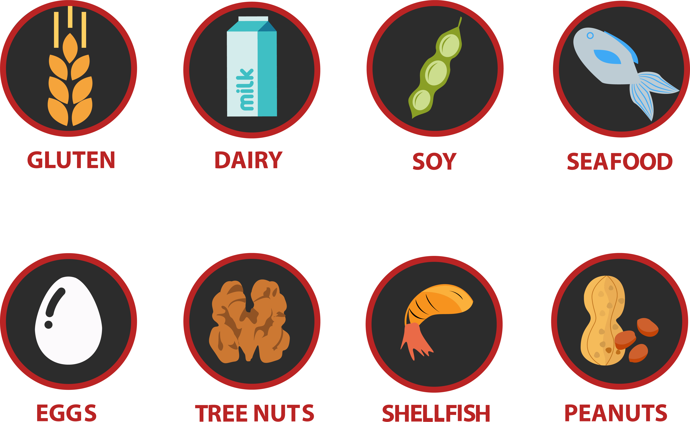
Meals Include Dietary Restrictions and Food Allergens
We only show you meals that work with your dietary restrictions and avoid those that contain food allergens
Notes:
When designing our app, we placed emphasis on healthy.
Each recipe is tailored to fit your dietary restrictions.
Allergic reactions to food can sometimes cause serious illness and death. Therefore we labeled our recipes with allergen information.

Slide 13
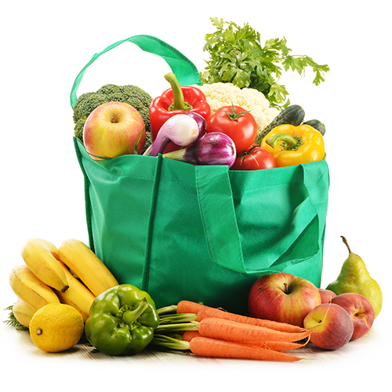
Fresh Ingredients From Your Chosen Local Grocery Store!
Every meal is prepared with fresh ingredients from your local grocery store
No need to walk through grocery aisles or make line at check out
Store prepares your order and has it ready before you arrive!
Notes:
Finally, cook it makes it easy for you to get your fresh ingredients from your local grocery store.
Once you select your meal and place your order, your list of ingredients is sent to your local grocery store where you can pick it up on your way home from work or school.

Slide 14

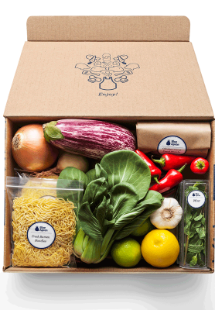
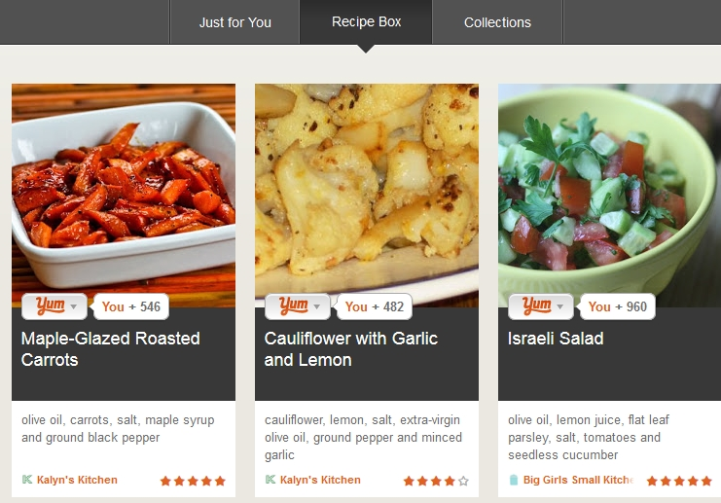
Our Competitors
Specific Grocery Store App
Blue Ribbon
Yummly
A blend of useful features incorporated
Some provide only recipes
Some provide meal kits
Some are specific to a store only
Notes:
CookIt incorporates useful features from current apps while leaving costly and problematic ones out.
The result is a simple, yet useful app to get your cooking done and get you on the right path to wellness.
Our app doesn’t tie you to a specific grocery store

Slide 15
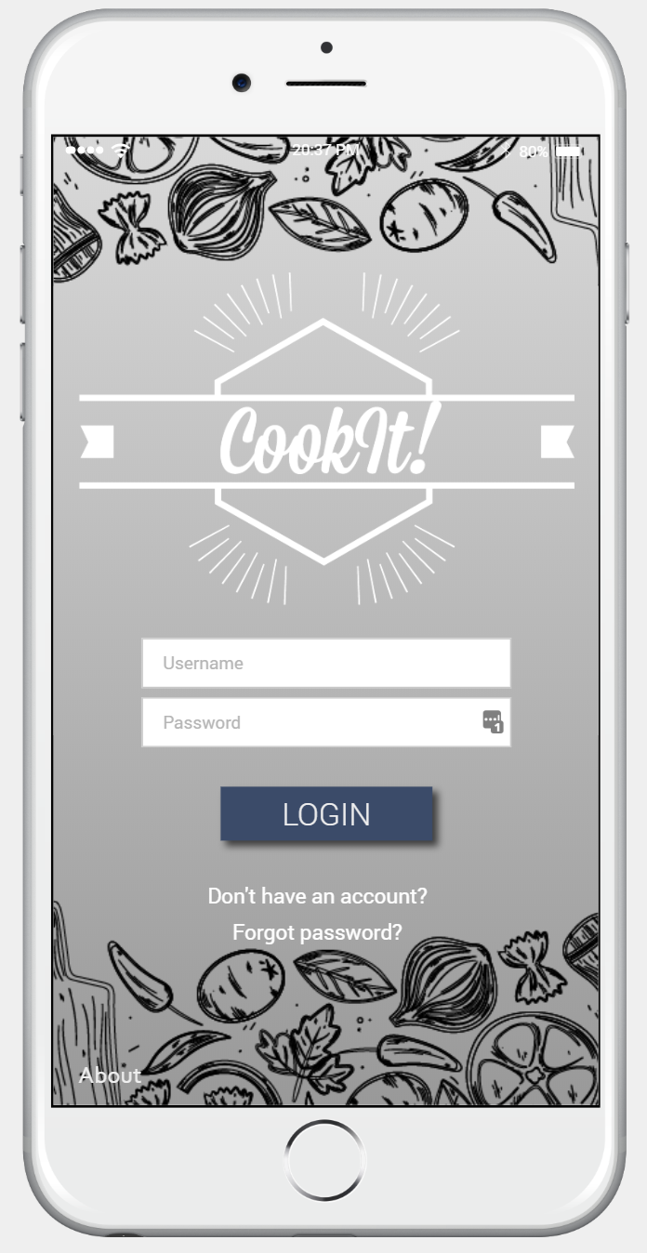
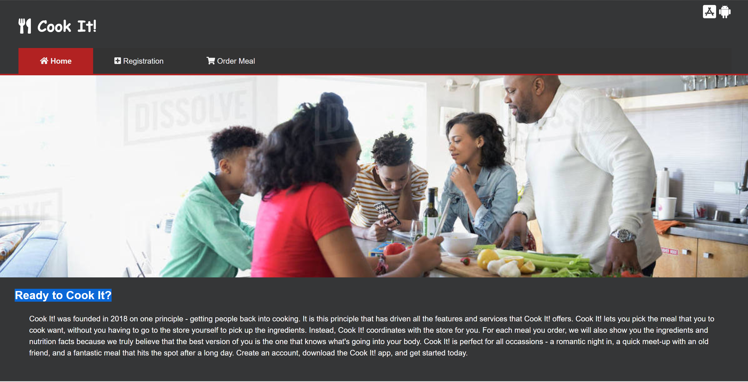
Solution Demo
Mobile Application:
https://goo.gl/2GUkti
Website:
https://goo.gl/VkeCsZ

Slide 16
Future Outlook
As a company we intend to integrate our system with the biggest grocery markets all across the country, allowing for markets to compete with fast food, and at the same time making it easier everyday for the consumer to get healthy and delicious food.
We plan to work with Grocers to integrate their product sales, and weekly specials.
For customers we plan to add new foods monthly and plan to add suggestions based on the customers purchase history, as well as use the data to show top dishes purchased
When fully established we plan to create contracts with the grocers for a percentage of each transaction or a service fee, depending on the amount of business that the business does using our service.

Slide 17

Questions?

